Slide 1
Analysing Employee Absenteeism
Mentor: Munna Pandey
submitted by: S. Pratheek
Wave number:4777
Batch Number:da374S37

Slide 2
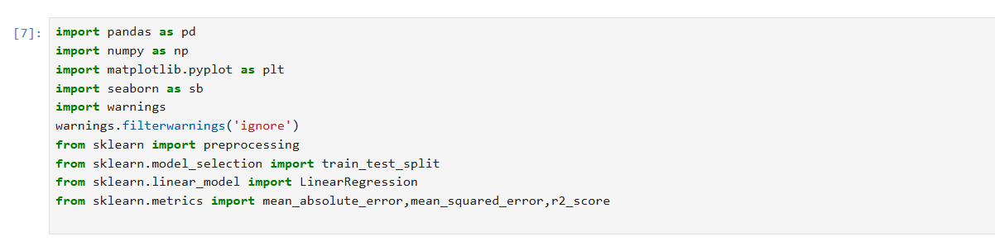
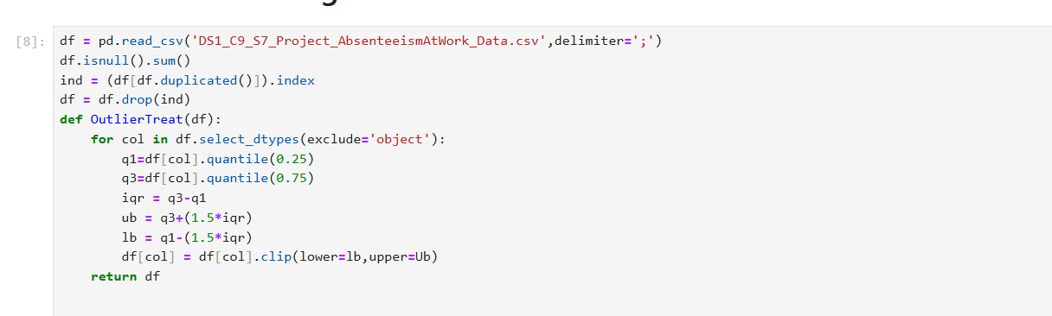
Data Cleaning

Slide 3
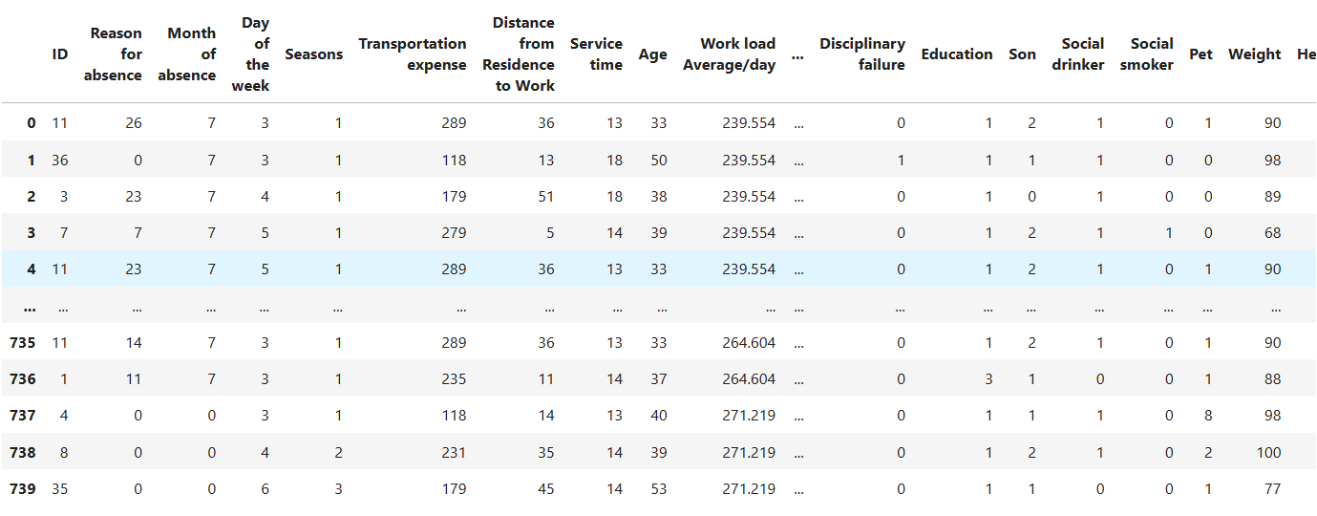
.
Interpretation:
The data is loaded in df using pandas and the duplicated values are removed from data and outlier analysis is perfromed using IQR and clip.

Slide 4
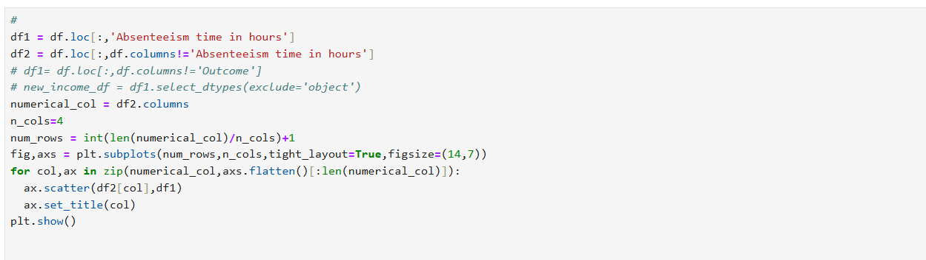
Understanding Absenteeism Patterns

Slide 5
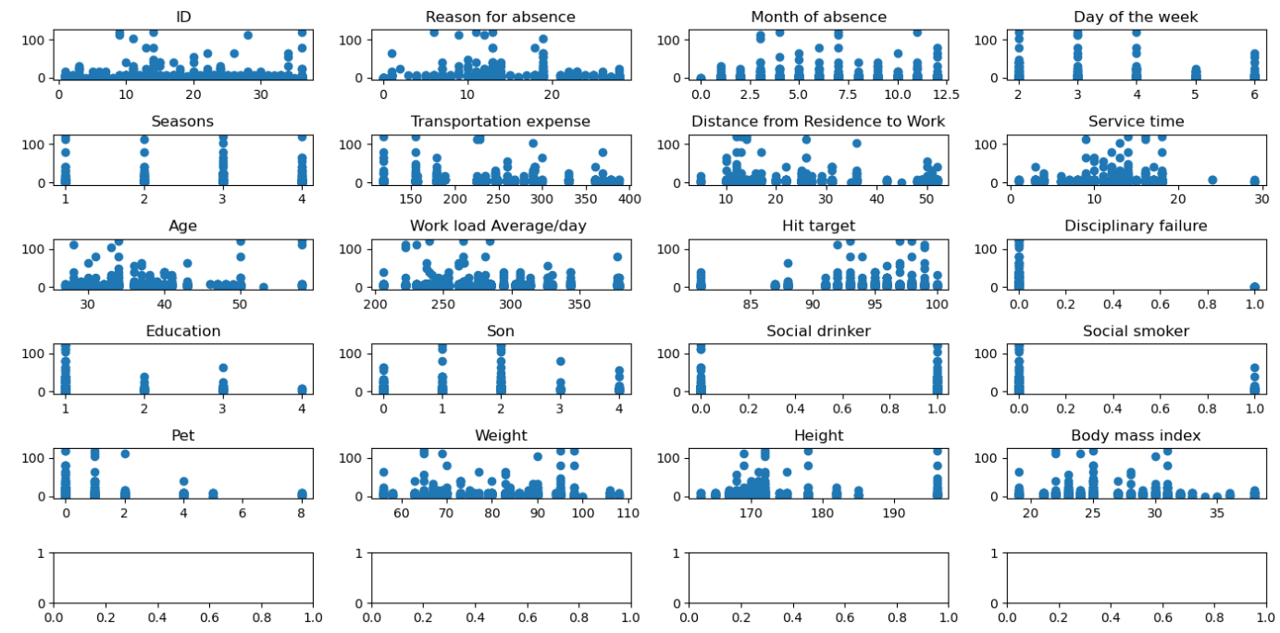
.

Slide 6
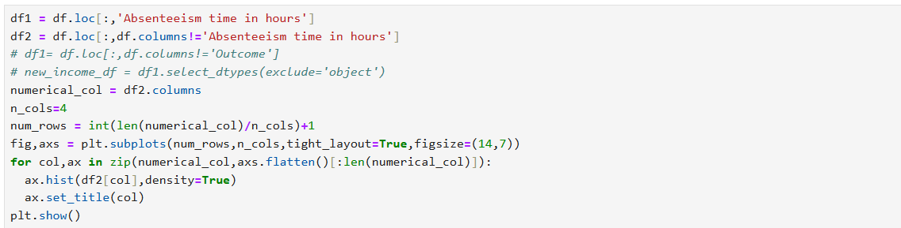

Slide 7
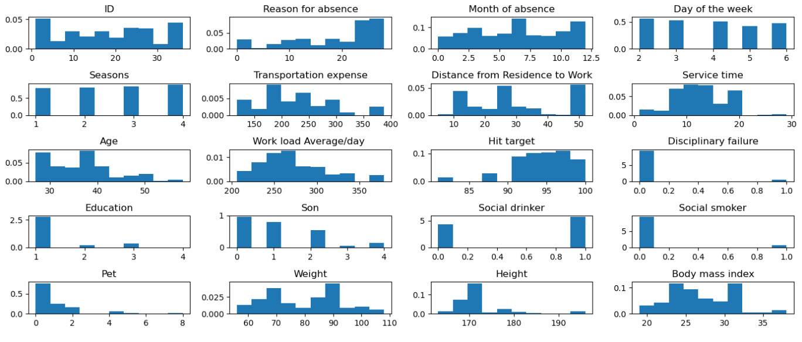
.
Interpretation: The relationship between each column and target column is displayed using scatter plot between independent and dependent features As are numeric column the data distribution of each column is visualized using histogram workload is right skewed

Slide 8
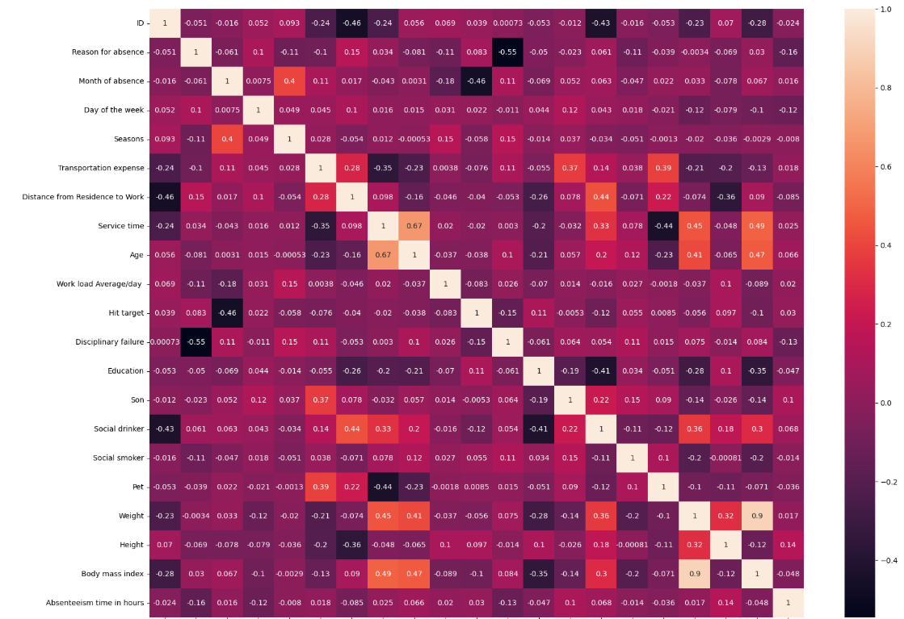
Analyzing Reasons for Absenteeism
Interpretation:
The reason of absenteeism is ananlyzed using heat map the correlation between features and target The reason of absence has hight negative correlation correlation in postive correlation heigh s highest

Slide 9
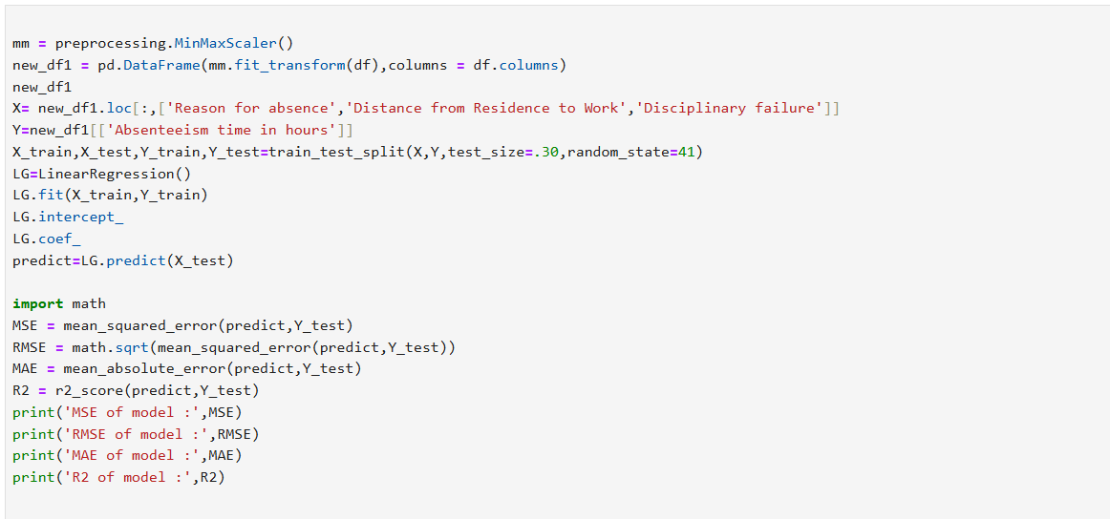

Predicting Absenteeism Duration
I
Interpretation:
The above is multiple linear regression model in the i have considered three features 'Reason for absence',' Distance from Residence to Work', 'Disciplinary failure.From multicolinearity the model as low mse,rmse,mae but due low r2 score the is less efficient in predictions but if compare other features it even worse

Slide 10
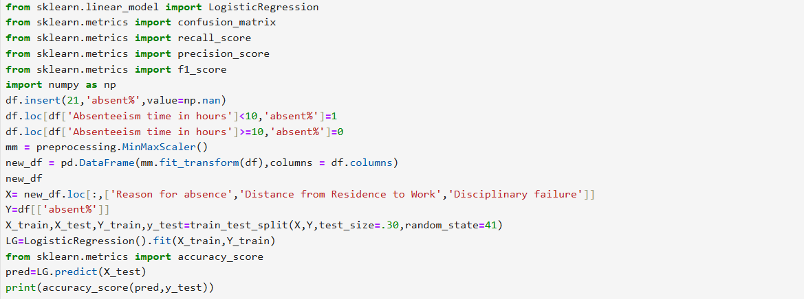
Identifying Employees at Risk of Absenteeism
Logistic regression

Slide 11
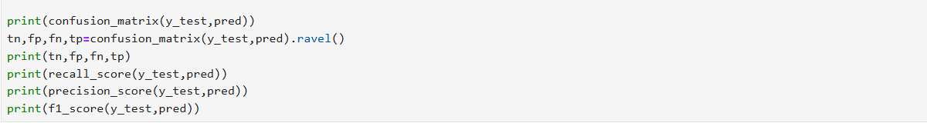
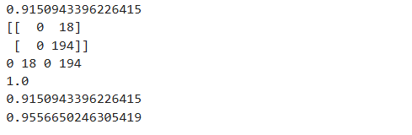
.

Slide 12
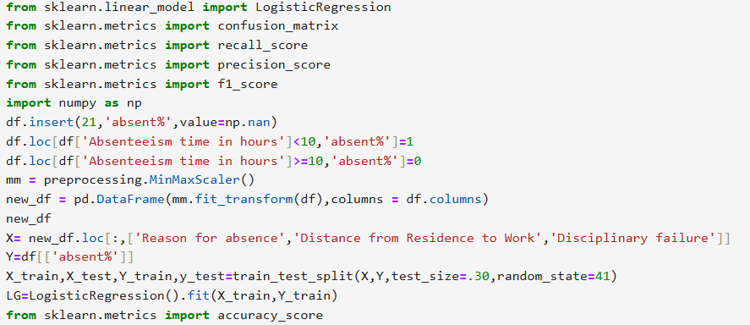
.

Slide 13
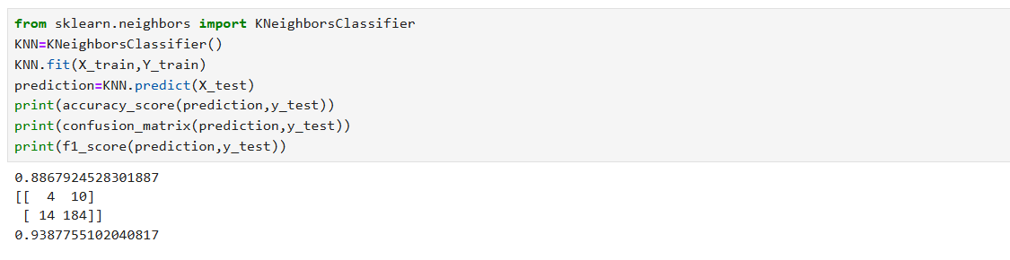
.
Interpretation:
For classification I have inserted a new column low attendance = 1high attendance =0
In both logistic and kmeans the kmeans classification has high accuracy than kmean classification

Slide 14
Summary and business conclusion
Removed duplicate rows. Treated outliers using the IQR method to ensure data consistency.
Scatter plots showed relationships between independent variables and absenteeism hours.
Workload distribution was right-skewed, indicating possible imbalances.
Heatmap analysis identified significant correlations between variables.
Reasons for absence showed the strongest correlation with absenteeism hours.
Normalized numerical features to prepare data for modeling. Categorical variables were encoded for
machine learning compatibility. Certain features (e.g., workload, transportation expense) were critical predictors.
Used Linear Regression to predict absenteeism hours.Evaluated the model with metrics like R², MSE, and MAE.
The model explained absenteeism well with reasonable accuracy.
The kmeans classification is better than logistic
Conclusion
Analysis identified key drivers of absenteeism.
Results can help organizations target and reduce employee absenteeism effectively. By understanding features which are scaled and critical and try to resolve them
By this organizations can reduce employee absenteeism

Slide 15
Thank you
.

